Slide 1
Aft -723 jury 1 Minor Project -2 J.B. MANIK 12300623

Slide 2

Idea – 2D Unity Game Development Project
Title: “Mani The Hero”
Key Points:
To develop a 2D game using the Unity engine.
To implement modern Unity features and best practices.
To demonstrate a wide range of game mechanics,
from core player controls to enemy AI and a save/load system.

Slide 3
Story
Player name is Mani , a traveler trapped in a cursed pixel world. To escape, you must master new abilities and fight corrupted enemies guarding of the ruins. Your journey begins in the Forgotten Forest and ends in the Dark Fortress, where a final guardian awaits.

Slide 4
Player Input
Unity New Input System
Player input mapping
Smooth controls for platformer

Slide 5
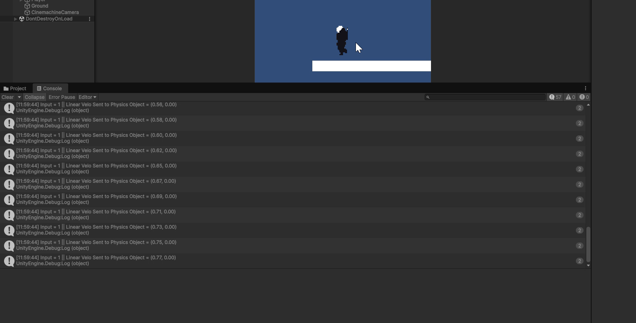
Player Input

Slide 6
State Machine & Abilities
State machine update for player
Jump, Wall Jump, Wall Slide
Dash abilities

Slide 7
Camera
Cinemachine camera setup

Slide 8
State machine
It will store all states like move, jump dash, wall slide, etc.
The state will be store as Enums.
The state machine will also have function to change states. Eg- from move to jump.
Enum states are used as identifiers for abelites. Eg- to use move ability the current state must be ( enum move state ).
Gather input stores general inputs and physics control script which responsible for detecting ground and walls , it will control player colliders and so on.
The player also contain the instance of state machine ( which contain the current state and all the states ).

Slide 9
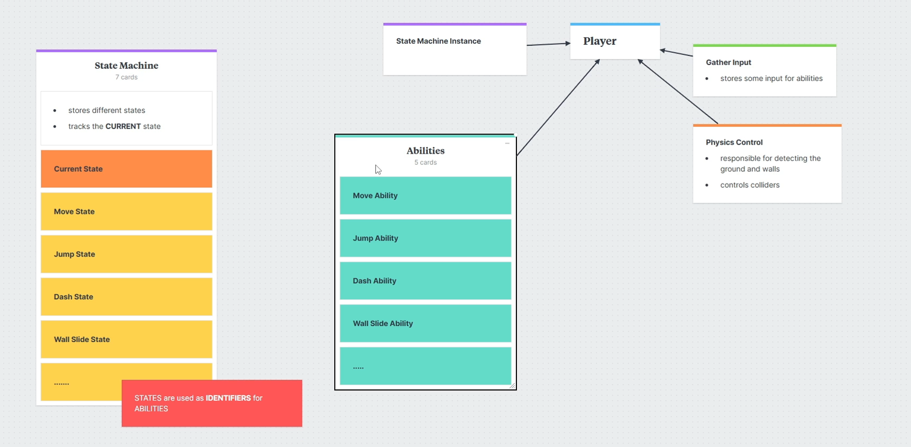
State machine

Slide 10
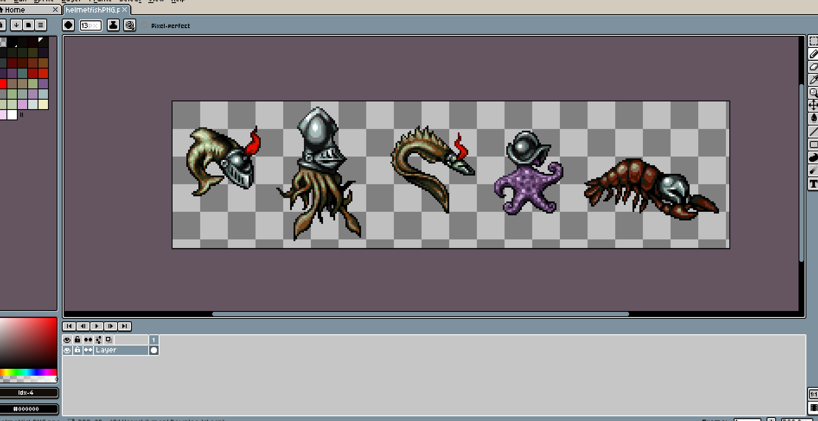
Sprites

Slide 11
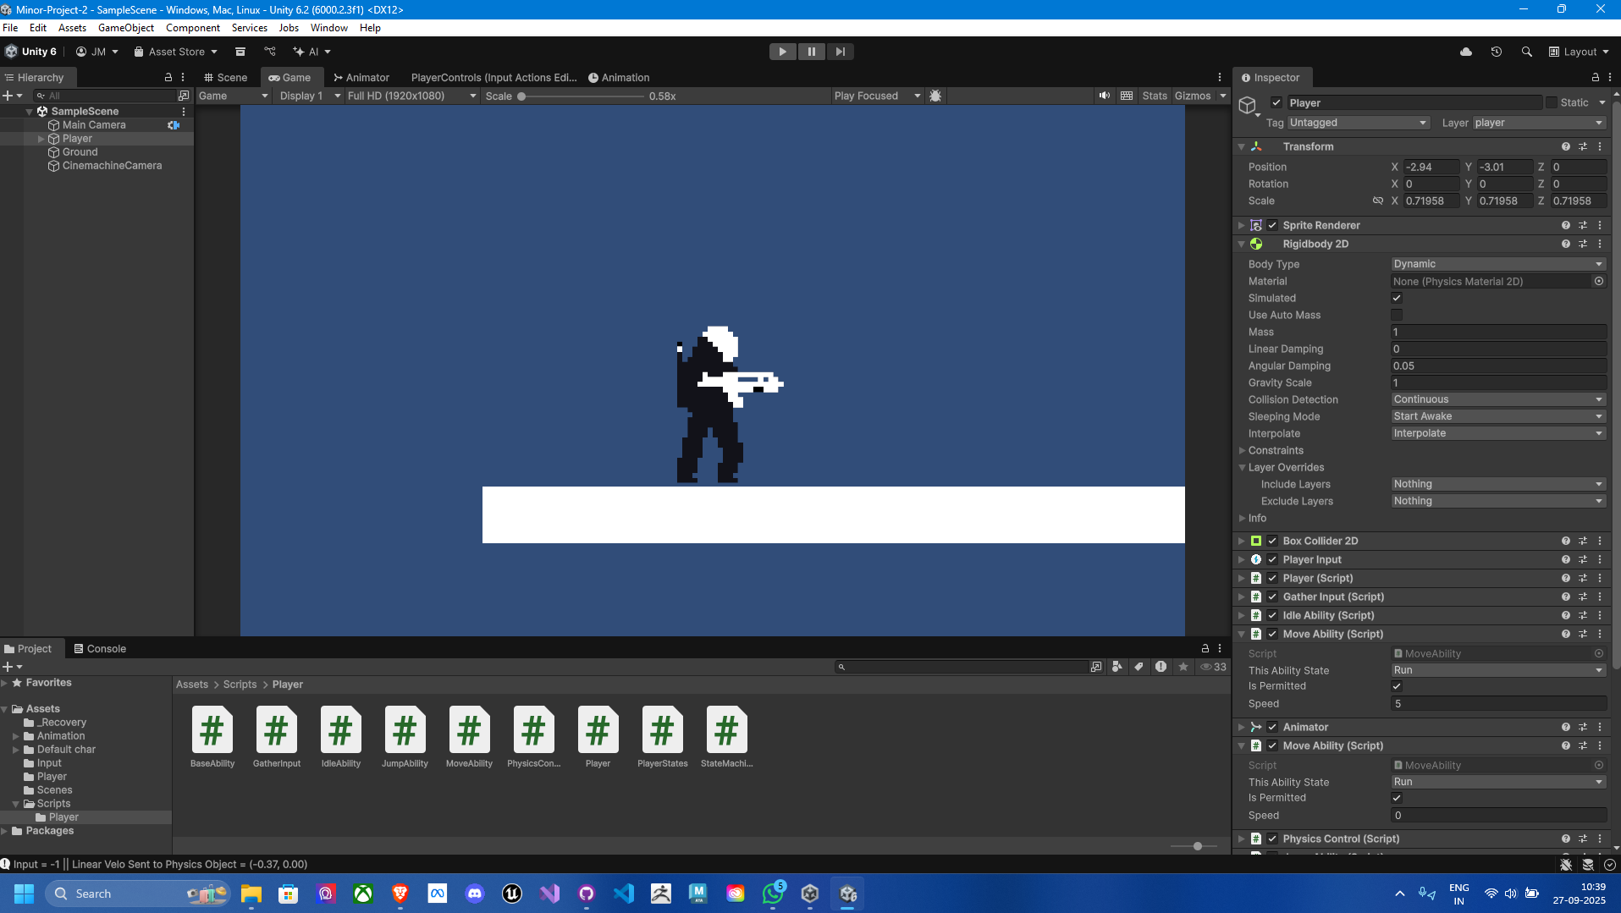
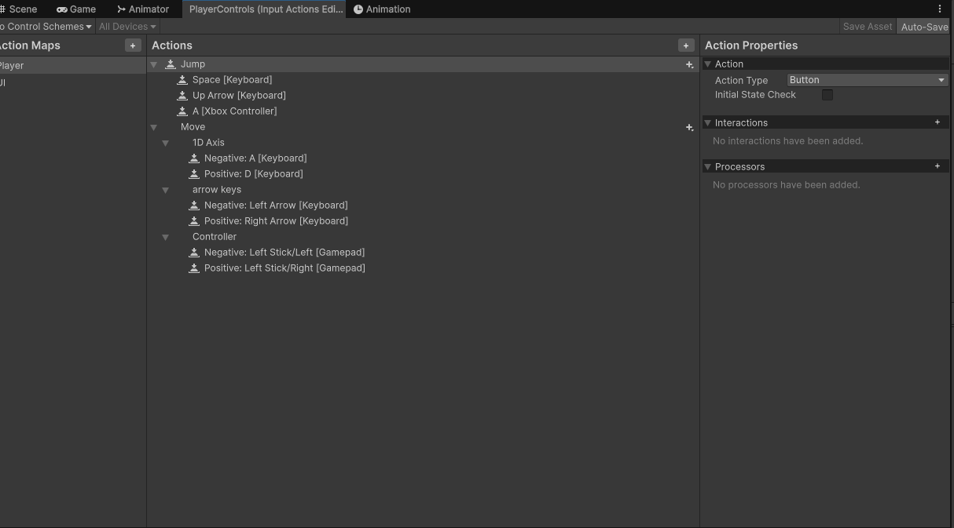
Scripts ands custom input system

Slide 12
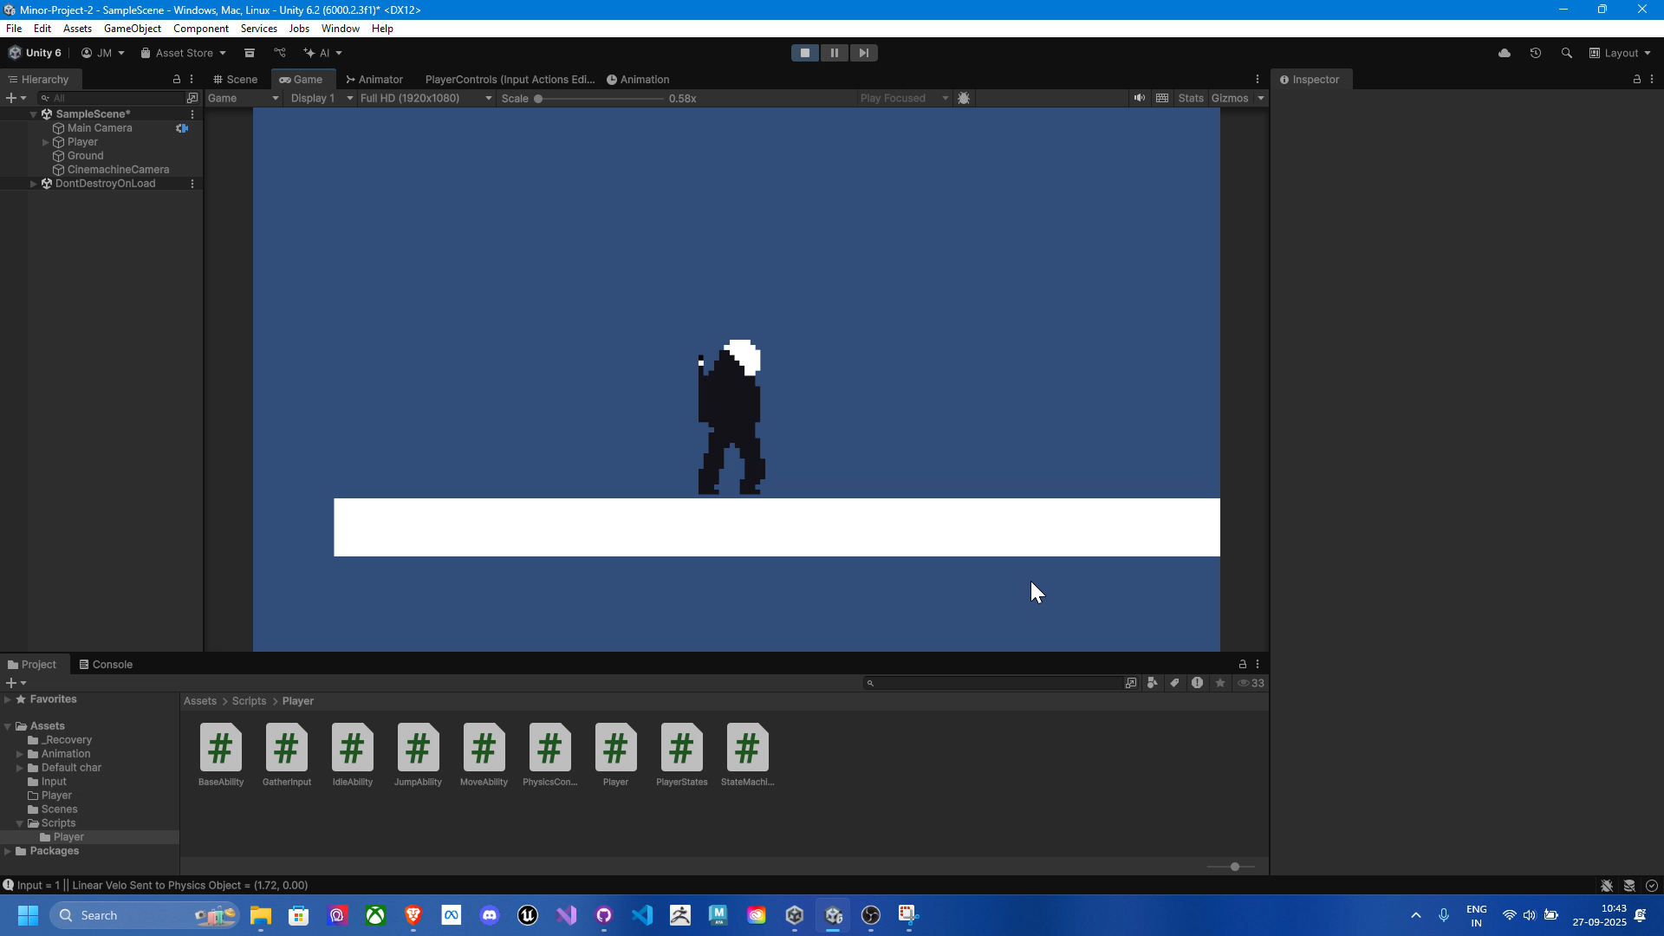
Game play

